Slide 1
FORECAST DEMAND OF CAR RENTALS ON HOURLY BASIS
Submitted by: Megha Ramesh

Slide 2
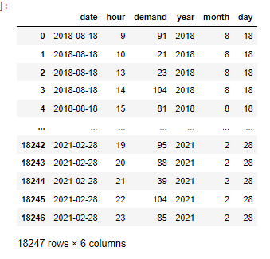
EDA
Check for null / duplicated values
Check data types and convert as applicable
Separate date data for visualisation

Slide 3
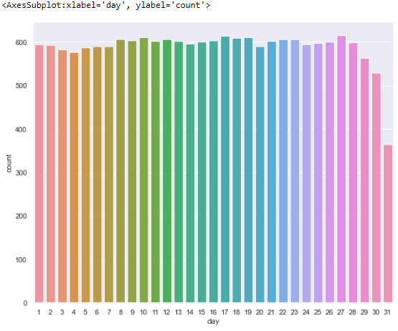
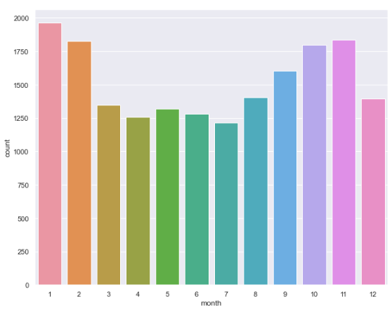
Visualisation to understand dataset
Demand decreases in the last few days of the month
Sales decreases in the first half of year and increase in the second

Slide 4
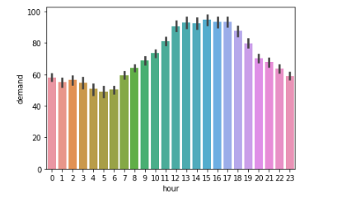
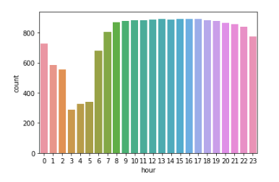
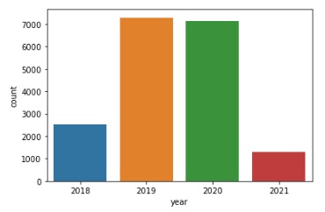
Peak demand is between 8am and 12 am
Demand has decreased in the last year

Slide 5
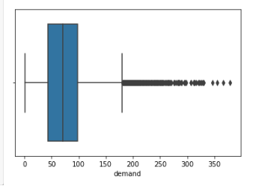
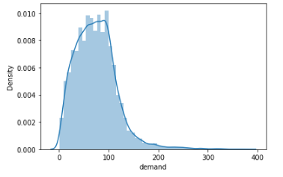
Outlier Detection
Check skewness
Develop boxplot to find outlier data point
Demand is right skewed
Outliers are present. Approx 1.2% data are outliers

Slide 6
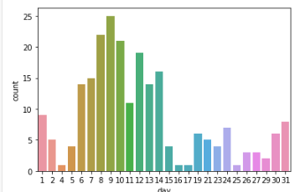
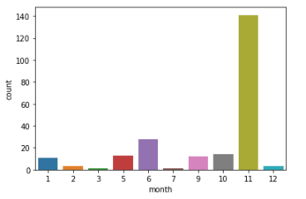
Max number of outlier data reported occur on 8-11th days of the month
Max number of outlier data reported occur in november

Slide 7
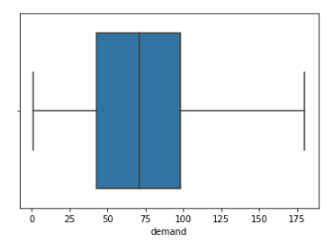
Dealing with outlier data
Outlier data are capped with a max value of 180

Slide 8
Model building
Data driven forecasting models
Model | RMSE
Simple Exponential Method | 49.2
Holt Method | 3408.9
Holt Winters Exponential Smoothing with Additive Seasonality and Additive Trend | 129.6
Holt Winters Exponential Smoothing with Multiplicative Seasonality and Additive Trend | 1060.7
Simple Exponential Smoothing has the least RMSE among data driven models

Slide 9
Model based forecasting methods
Model | RMSE
Linear Model | 40.9
Exponential Model | 82.9
Quadratic Model | 40.9
Additive Seasonality Model | 37.0
Additive Quadratic Seasonality Model | 37.4
Multiplicative Seasonality Model | 82.2
Multplicative Quadratic Seasonality Model | 82.9
Additive Quadratic Seasonality Model has least RMSE among model based forecasting models
Additive Quadratic Seasonality Model is selected for Forecasting

